Slide 1
DOUBLY LINKED LISTS

Slide 2
Traversal of items can be done in both forward and backward directions.
Every node contains an additional prev pointer that points to the previous node.
Each node consists of 3 components:
1.*prev - address of the previous node
2. data - data item
3. *next - address of next node

Slide 3
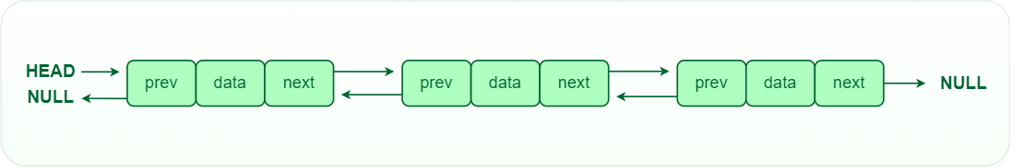

Slide 4
So for a doubly linked linked lists a single node is represented as :
struct node
{
int data; //data item
struct node *next; //pointer to address of next node
struct node *prev; //pointer to address of previous node
}

Slide 5
/* Initialize nodes */
struct node *head;
struct node *one = NULL;
struct node *two = NULL;
struct node *three = NULL;
/* Allocate memory */
one = malloc(sizeof(struct node));
two = malloc(sizeof(struct node));
three = malloc(sizeof(struct node));
/* Assign data values */
one->data = 1;
two->data = 2;
three->data = 3;
/* Connect nodes */
one->next = two;
one->prev = NULL;
two->next = three;
two->prev = one;
three->next = NULL;
three->prev = two;
/* Save address of first node in head */
head = one;
Note: In the case of the head node, prev points to null, and in the case of the tail pointer, next points to null.

Slide 6
Circular linked list
A circular linked list is a type of linked list in which the first and the last nodes are connected to each other thus formming a circle, there is no NULL at the end.
Instead of the last node having a NULL pointer,It instead has the address of the head node . Hence the reason for saying the first and last nodes are connected.

Slide 7
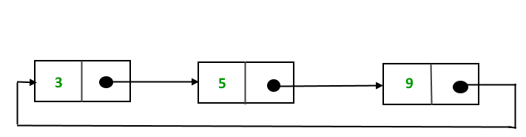

Slide 8
/* Initialize nodes */
struct node *last;
struct node *one = NULL;
struct node *two = NULL;
struct node *three = NULL;
/* Allocate memory */
one = malloc(sizeof(struct node));
two = malloc(sizeof(struct node));
three = malloc(sizeof(struct node));
/* Assign data values */
one->data = 1;
two->data = 2;
three->data = 3;
/* Connect nodes */
one->next = two;
two->next = three;
three->next = one;
/* Save address of third node in last */
last = three;

Slide 9
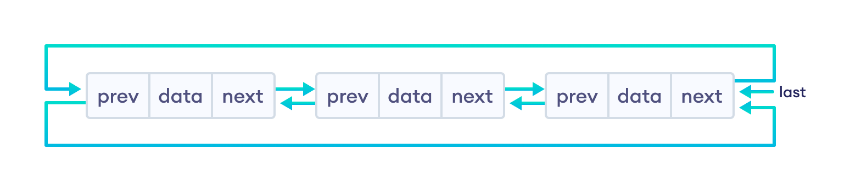
Doubly linked Circular Linked List

Slide 10
Challenge
Write functions to perform the following functions on a doubly linked list :
  1. Insert data into the list at the beginning , in the middle and at the end
  2. Delete data from the list.
Write functions to perform the following functions on a circular linked list :
  1. Insert data into the list at the beginning , in the middle and at the end.
  2. Delete data from the list.

